Slide 1
Chapter 15

Slide 2
Objectives

Slide 3
Objectives (continued)

Slide 4
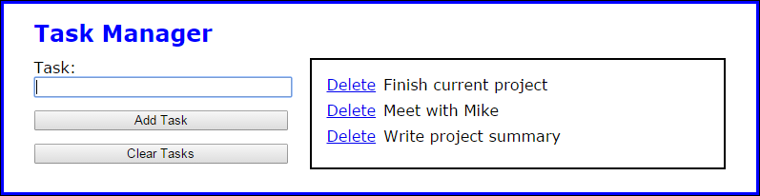
The Task Manager application

Slide 5
The global objects created by previous versions of the Task Manager application

Slide 6
Problems with adding functions and objects to the global namespace

Slide 7
How to create a namespace

Slide 8
How to add objects to a namespace

Slide 9
How to add objects to a namespace (continued)

Slide 10
How to use the objects in a namespace

Slide 11
How to create a nested namespace

Slide 12
How to use nested namespace objects without aliasing

Slide 13
A nested namespace creator function

Slide 14
How to use the creator function to create namespaces

Slide 15
How to prevent global pollution with an IIFE that defines and assigns event handlers

Slide 16
The library_namespace.js file for the Task Manager application

Slide 17
The library_storage.js file

Slide 18
The library_tasklist.js file

Slide 19
The library_tasklist.js file (continued)

Slide 20
The main JavaScript file

Slide 21
The main JavaScript file (continued)

Slide 22
The main JavaScript file (continued)

Slide 23
The pros and cons of object literals vs closures

Slide 24
A module pattern that creates a single slideshow object with private state

Slide 25
An example that uses an IIFE to augment the slideshow object

Slide 26
Using the slideshow object’s new method

Slide 27
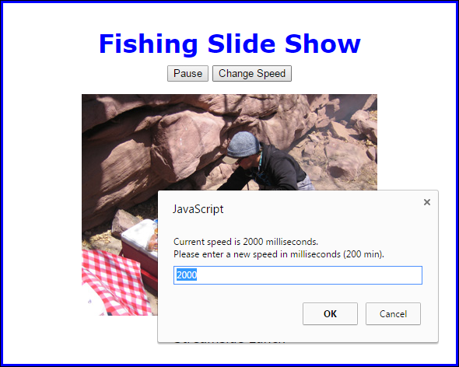
The Slide Show when the Change Speed button is clicked

Slide 28
The HTML

Slide 29
The library_slide_show.js file

Slide 30
The library_slide_show.js file (continued)

Slide 31
The library_slide_show_enhancements.js file

Slide 32
The main JavaScript file

Slide 33
The main JavaScript file (continued)

Slide 34
Three of the attributes of an object property

Slide 35
Two ways to enumerate an object’s properties

Slide 36
Direct vs inherited properties

Slide 37
Examples of enumerating direct and inherited properties

Slide 38
Examples of enumerating direct and inherited properties (continued)

Slide 39
Terms

Slide 40
The syntax of the defineProperty method of the Object object

Slide 41
The two descriptor types

Slide 42
Terms

Slide 43
How to create custom data properties using Object.defineProperty

Slide 44
How to create custom data properties using Object.defineProperty (continued)

Slide 45
How to create custom accessor properties using Object.defineProperty

Slide 46
How to create custom accessor properties using Object.defineProperty (continued)

Slide 47
The syntax of the defineProperties method of the Object object

Slide 48
How to use the Object.defineProperties method

Slide 49
The syntax of the create method of the Object object

Slide 50
How to use the Object.create method

Slide 51
Object methods that return information about an object’s properties

Slide 52
Examples based on the Object.create example

Slide 53
Examples (continued)

Slide 54
Examples (continued)

Slide 55
The library_slide_show.js file

Slide 56
The library_slide_show.js file (continued)

Slide 57
The library_slide_show_enhancements.js file

Slide 58
The main JavaScript file

Slide 59
The main JavaScript file (continued)

Slide 60
Exercise 15-1 Try to break the Slide Show apps

Slide 61
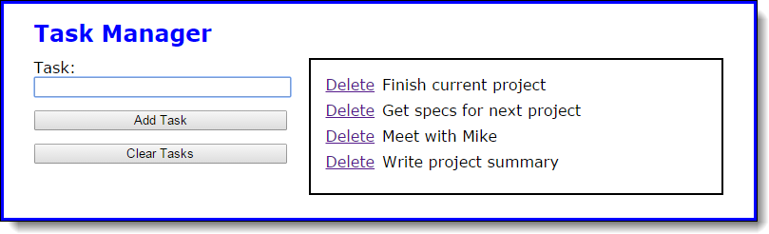
Exercise 15-2 Add namespaces to Task Manager

Slide 62
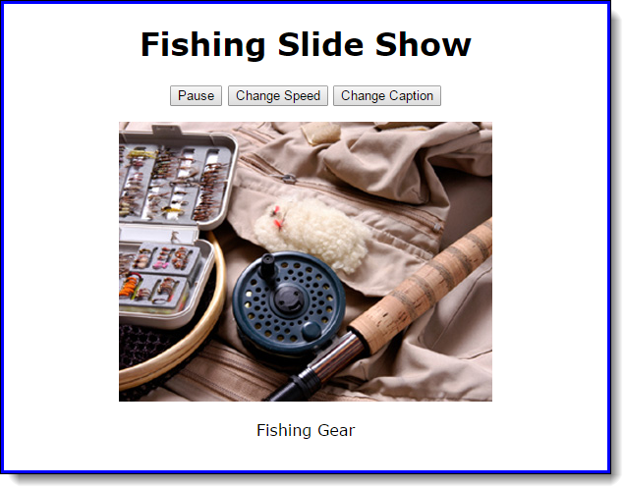
Exercise 15-3 Modify a Slide Show app

Slide 63
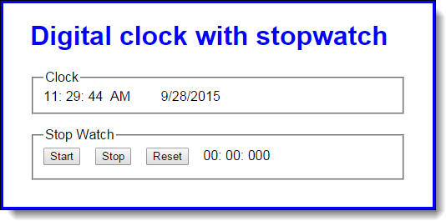
Extra 15-1 Use namespaces and the module pattern with the Clock app

Slide 64

Extra 15-2 Enhance the stopwatch

Slide 65
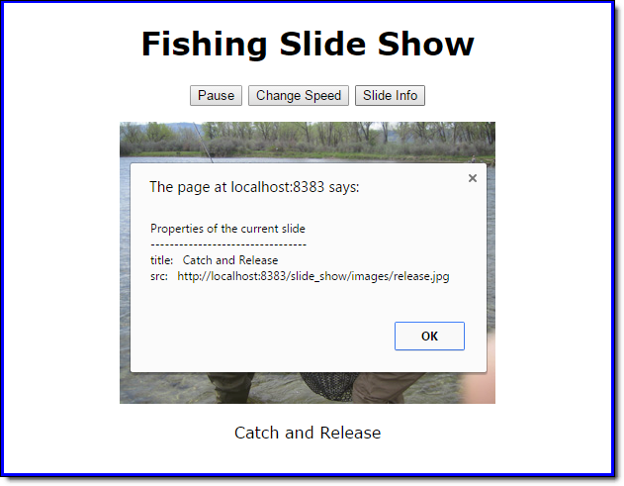
Short 15-1 Modify a Slide Show app

